Slide 1
REACT
SPRING BOOT
Router
Components
Service
Axios HTTP
Animation
Spring Rest Controller
Spring S3 Client Controller
Spring DAO/Repository/Entity/Model JPA
PostgreSQL
S3 Service Layer
AWS S3

Slide 2
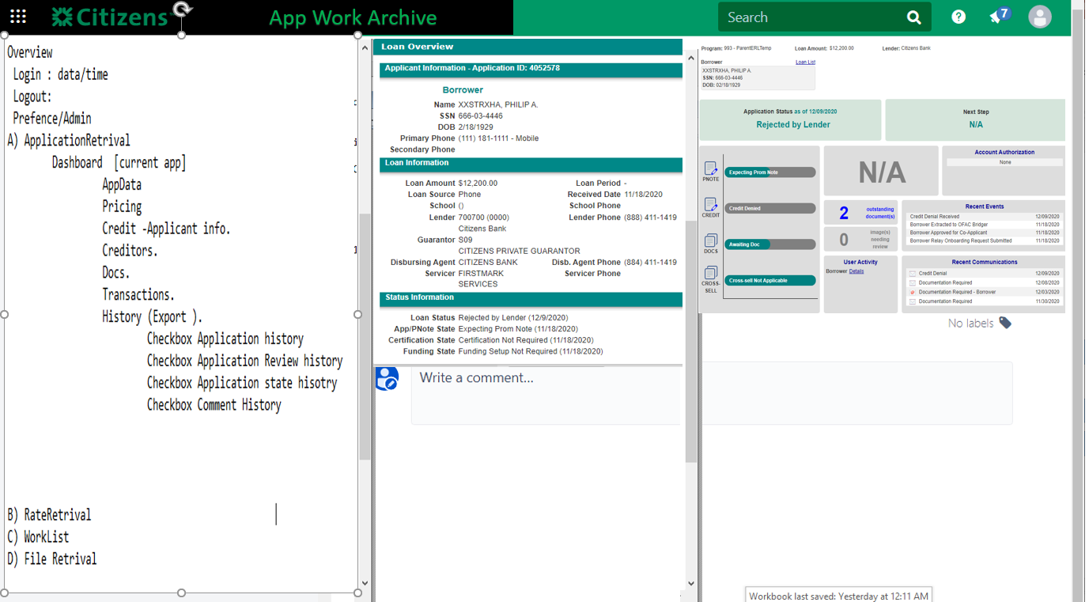

Slide 3
React – Router/Components/Service/APIs
Lender/loan/dashboard/application/id
ApplicationDataList
Lender/loan/dashboard/pricing/id
PricingList
/lender/loan/Appretrival/Application/id
AppRetrivalApplicaitonIDList
Lender/loan/dashboard/creditlist/id
CreditList
/lender/loan/Appretrival/ssn
AppRetrivalSSNList
Lender/loan/dashboard/creditorlist/id
CreditorList
/lender/loan/Appretrival/firstname
AppRetrivalFirstNameList
Lender/loan/dashboard/docslist/id
DocsList
/lender/loan/Appretrival/lastname
AppRetrivalLastNameList
TransactionsList
Lender/loan/dashboard/transactionlist/id
App
Lender/Admin/WebUserMantenance
Admin
Router
Dashboard
AppRetrivalDataService
REQUEST
axios
Lender/Worklist/CreditProcessing/Application/id
Lender/Worklist/CreditProcessing/ssn/id
RESPONSE
Lender/Worklist/CreditProcessing/Worklists/id
CreditProcessingList
/lender/loan/RateRetrival/RecordID/id
Lender/Worklist/CreditProcessing/Program/id
RateRetrivalRecID
Lender/Worklist/CreditProcessing/DocumentStatus/id
/lender/loan/RateRetrival/ssn
Lender/Worklist/CreditProcessing/DocumentStatus/id
RateRetrivalSSN
Lender/FileRetrieval/ViewReports
Lender/FileRetrieval/ViewLetters
Lender/FileRetrieval/ViewBatchLogs
Lender/FileRetrieval/ViewUtilityLogs
Lender/FileRetrieval/ViewDataFiles
/lender/loan/RateRetrival/lastName
FileRetrivalList
RateRetrivalLastName

Slide 4
Spring Backend Services
/ApplicationData
APIGateway
Log Service
/Pricing
/RateRetrival
/Credit
RateRetrivalService
/Creditor
DashBoradServices
Request
/Docs
/AppRetrival
/Transactions
ApplicationRetrivalService
/Admin
Log Service
/CreditProcessing
ConfigService
/FileRetrival
AWSSBucketService
DatabaseService

